Slide 1
Investigation of Microcystis Cell Density and Phosphorus in Benthic Sediment and Their Effect on Cyanobacterial Blooms on Western Lake Erie in the Summer of 2009
Erik Lange
Department of Civil Engineering
University of Toledo

Slide 2
Hypothesis
Microcystis cells and phosphorus stored in the sediment of the Western Lake Erie Basin reinvade the water column and directly affect Microcystis spp. cell density in the lake during a cyanobacterial bloom.

Slide 3
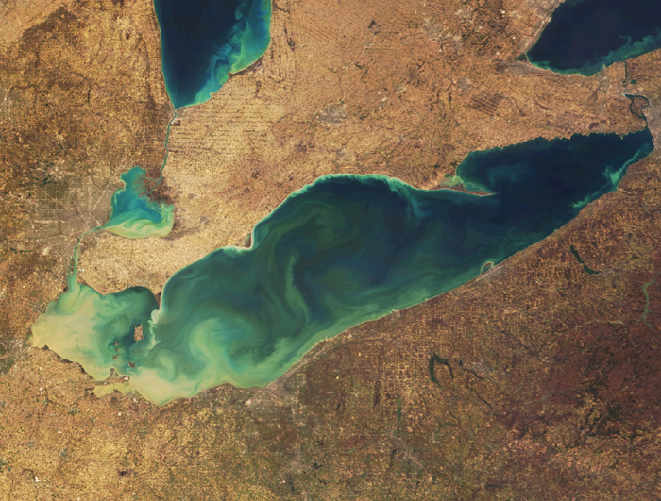
INTRODUCTION

Slide 4
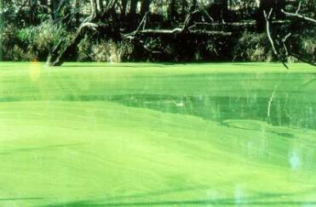
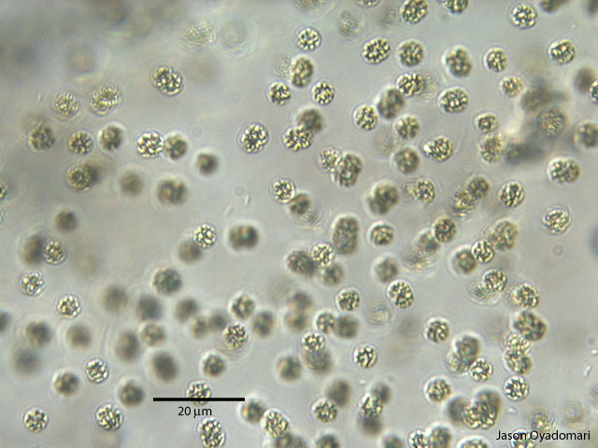
Blue Green Algae
  Blue-green algae blooms (caused by species of the Cyanobacteria phylum) can be problematic on eutrophic lakes
  Dominant species in these cyanobacterial blooms on eutrophic lakes is often of the Microcystis genus
    Forms colonies

Slide 5
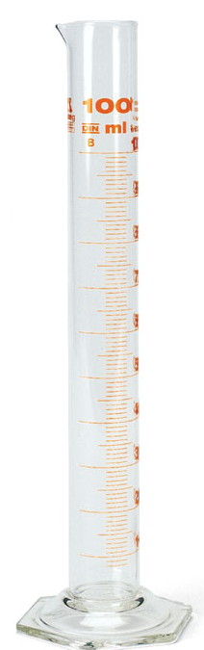
Enumeration of Microcystis Cells From Water Samples
Buoyancy caused by high gas content vesicle
Vertical migration in the water column
Buoyancy can be used to separate Microcystis spp. cells from other planktonic Cells
Sedimentation by 100 ml graduated cylinder

Slide 6

Lake Erie and Microcystis Blooms
Historically, Lake Erie has been highly productive.
By the 1960’s, poor water quality and cyanobacterial blooms common
1970’s phosphorus loading limited and water quality improved

Slide 7
Lake Erie and Microcystis Blooms
Blooms have returned
Microcystis cell density in the Western Lake Erie basin ranged from 4x10⁸ to 4x10³ cells per liter in August of 2003 and 2004 (Rinta-Kanto, 2005)
World Health Organization’s recommendations for microcystin levels in drinking water sources was exceed in Lake Erie

Slide 8
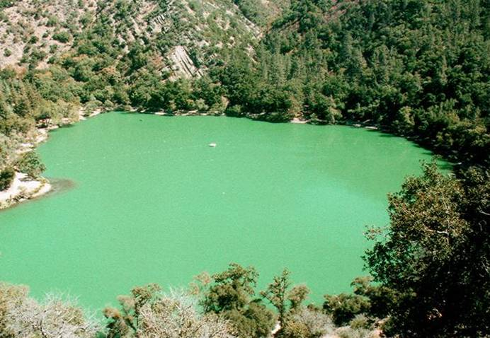
Microcystis Cells in Lake Water
Microcystis spp. blooms affect eutrophic water systems around the globe
Between 1998 and 2000, a lake in Turkey had cell density concentrations between 2.9 x 10⁴ and 2.7 x 10⁶ cells per milliliter (Tas, 2006)

Slide 9

Microcystis Cells in Lake Water
Phosphorus and nitrogen promote cyanobacterial growth
Phosphorus is generally the limiting nutrient
Phosphorus has been shown to migrate with Microcystis cells from the sediment
Iron can also be a limiting factor because it is necessary for nitrogen fixation

Slide 10
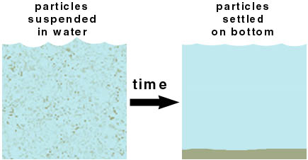
Microcystis Cells in Lake Water
Due to the individual cell’s ability to alter buoyancy, Microcystis colonies often undergo vertical movement
In late summer 2004, a lake in the Czech Republic had Microcystis cell density peak in September at shallow sites and in October at deeper sites (Gregor, 2006)
Microcystis Cell Lifecycle:
  Summer Pelagic Growth
  Sedimentation
  Overwintering in Sediment
  Reinvasion of Water Column

Slide 11
Microcystis Cells in Lake Sediment
Microcystis spp. colonies can dominate the microbial community within lake sediment
In the summer, the surface sediment of a lake in Turkey had a cell density of 2.78 x 10⁶ colonies per square meter (Brunberg, 2003)
Microcystis spp. cells can survive and slowly accrue mass for long periods of time in lake sediment.

Slide 12

Microcystis cells in lake sediment:
The Concerns
Reinvading cells transfer phosphorus from the sediment to the water column
It has been simulated that a summer Microcystis spp. bloom would be reduced by 50% if reinvasion was halted and by 64% if sedimentation and overwintering was halted (Verspagen, 2005)

Slide 13
Are Microcystis spp. Blooms Affected By Sediment Cell Density in Lake Erie?
Can This Source of Cells Be Controlled to Limit These Blooms?

Slide 14

METHODS

Slide 15
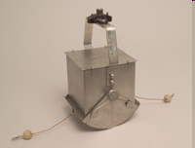
Sample Collection By
Tom Bridgeman and his students
June, August, September
Ekman Dredge

Slide 16
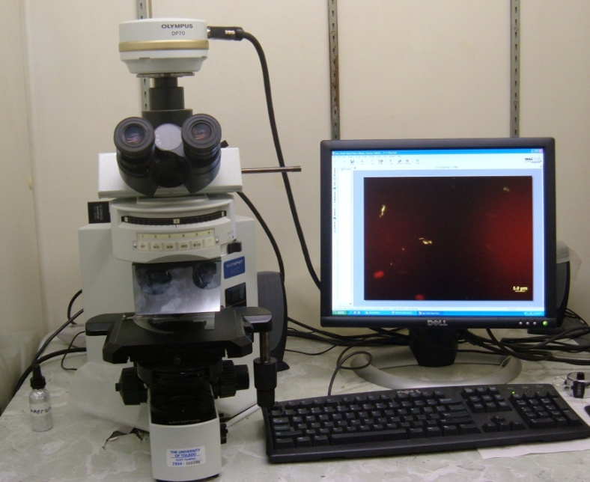
Microcytis spp. Detection
Microcystis spp. in sediments
5 g suspended in 1L.
48 hrs sedimentation
15 mL collected.
Fixed in 10% formalin
3 min sonication
Filter on black polycarb filter (0.22um)
400X on fluorescent scope
  Phycobiliproteins

Slide 17
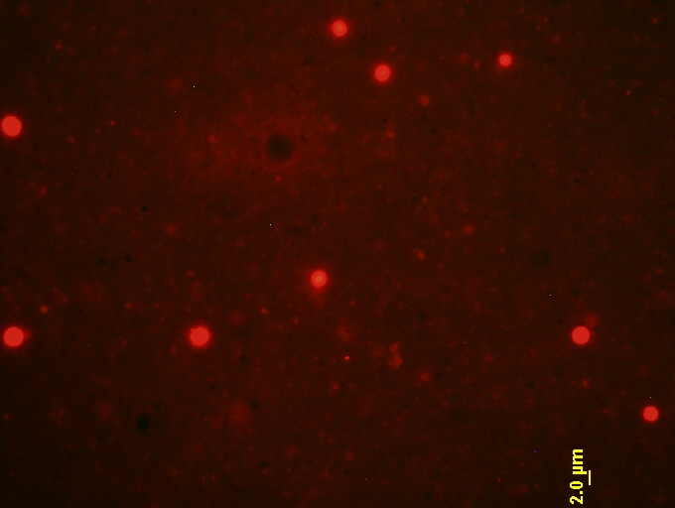
A photograph taken of a field on a slide from the second sampling date of the sediment samples at site 7M. This photograph was taken with the use of a fluorescence microscope at 400X magnification.

Slide 18
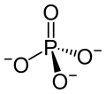
Phosphorus Concentrations
Duplicate sediment samples were blended to one composite sample
Those samples were processed by Heidelberg Water Quality Lab (Jack Kramer)
Three concentrations found:
  Total phosphorous
  Soluble phosphorous
  Iron strip test Phosphorous

Slide 19
Microcytis spp. Detection
Microcystis spp. in lake water
48 hrs sedimentation
15 mL collected.
3 min sonication
Filter on black polycarb filter (0.22um)
400X on fluorescent scope

Slide 20
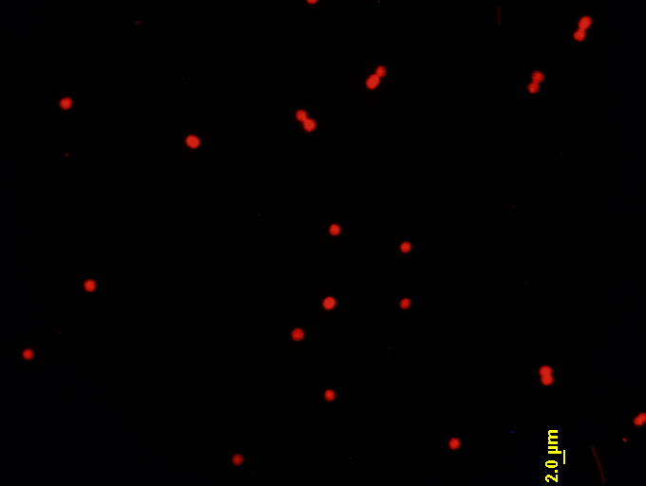
A photograph taken of a field on a slide from the second sampling date of the lake samples at site MB20. This photograph was taken with the use of a fluorescence microscope at 400X magnification.

Slide 21
Detection Limits
Microcystis cell density values in sediment:
  560 cells/gram dry weight of sediment
  Only buoyant cells large enough to be detected at 400X magnification
Microcystis cell density values in lake water:
  2,800 cells/mL

Slide 22
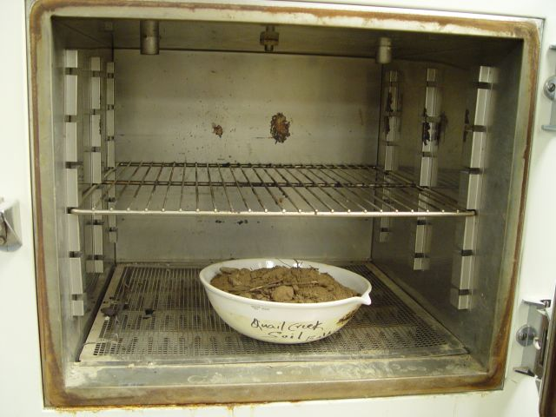
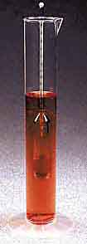
Other Tests
Percent Dry Solid of Sediment Samples
  According to Department of Sustainable Natural Resources
  Phosphorus data and sediment Microcystis cell density adjusted to reflect dry weight of samples
Grain Size Distribution
  According to ASTM D 422
  Type 152H hydrometer

Slide 23
RESULTS

Slide 24
Quantification of Microcystis spp. Cells in Lake Water
Microcystis cell density (cell/mL) in lake water as a function of sampling site (MB20, MB18, 8M, 7M, GR1, 4P) and as a function of sampling date (June, August, September).

Slide 25
Quantification of Microcystis spp. Cells in Lake Water
No cell density values found on June 9, 2009. This sampling date is considered before the bloom at all sites
No cell density values found at site 4P (the furthest site from shore)
For sites MB20, MB18, 8M, and GR1: the highest cell density value was found on August 4, 2009. The second sampling date is considered during the bloom. September 14, 2009 is after the bloom
At site 7M the bloom lingered into the third sampling date

Slide 26
Quantification of Microcystis spp. Cells in Lake Sediment
Microcystis cell density (cell/mL) in sediment samples as a function of sampling site (MB20, MB18, 8M, 7M, GR1, 4P) and as a function of sampling date (June, August, September).

Slide 27
Quantification of Microcystis spp. Cells in Lake Sediment
Very few cells large enough to be detected at the first sampling date (before the bloom)
No significant increases or decreases in Microcystis spp. cell density in sediment from second to third sampling dates (during the bloom to after the bloom)
Cells of a detectable size found during and after the bloom at each of the six sampling sites (detectable cells were not found in the water column at site 4P during either of these dates)

Slide 28

DISCUSSION

Slide 29
Analysis of Results
Microcystis spp. blooms, as expected, were peak in August
Total phosphorus concentrations in sediment are elevated, but not as high as other results that have been found
Grain size of sediments contributed to total and iron strip test phosphorus concentrations, but no significant correlation could be found with cell density in the sediment or in the water column

Slide 30
Comparison of Results to Prior Research
Significant increases in quantities were witnessed from before to during the bloom in both the sediment and water column
  The sediment is a source of Microcystis cells that affect the bloom in Lake Erie
Large cells did not decrease in the sediment from the second to the third sampling date
  Cells undergoing sedimentation were re-depositing into the sediment

Slide 31
CONCLUSION
Sediment was acting as a source of Microcystis spp. cells that directly affected the cell density of Microcystis spp. cells in cyanobacterial blooms in the Western Lake Erie Basin
Future research concentrating on eliminating the seasonal recycling of Microcystis cells between the sediment and water column in eutrophic lakes may result in techniques to control toxin levels in the Western Basin of Lake Erie

Slide 32
References
Bostrom, Bengt, Anna-Kristina Patterson, and Ingemar Ahlgren, “Seasonal Dynamics of a Cyanobacteria-Dominated Microbial Community in Surface Sediments of a Shallow, Eutrophic Lake,” Aquatic Sciences, 1989, vol. 51, no. 2, 153-178.
Brunberg, Anna-Kristina and Peter Blomquist, “Recruitment of Microcystis (Cyanophyceae) from Lake Sediments: The Importance of Littotal Inocula,” Journal of Phycology, 2003, vol. 39, 58-63.
Gregor, Jakub, Blahoslav Marsalek, and Helena Sipkova, “Detection and Estimation of Potentially Toxic Cyanobacteria in Raw Water at the Drinking Water Treatment Plant by In Vivo Fluorescence Method,” Water Research, 2007, vol. 41, 228-234.
Johnk, Klaus D, Jef Huisman, Jonathan Sharples, Ben Sommeijer, Petra M. Visser, and Jasper M. Strooms, “Summer Heatwaves Promote Blooms of Harmful Cyanobacteria,” Global Change Biology, 2008, vol. 14, 495-512.
Rinta-Kanto, J.M., A.J.A. Ouellette, G.L. Boyer, M.R. Twiss, T.B. Bridgeman, and S.W. Wilhelm, “Quantification of Toxic Microcystis spp. During the 2003 and 2004 Blooms in Western Lake Erie using Quantitative Real-Time PCR,” Environmental Science Technology, 2005, vol. 39, no. 11, 896-901.
Tas, Seyfettin, Erdogan Okus, and Asli Aslan-Yilmaz, “The Blooms of a Cyanobacterium, Microcystis cf. aeruginosa in a Severely Polluted Estuary, the Golden Horn, Turkey,” Estuarine, Coastal and Shelf Science, 2006, vol. 68, 593-599.
Verspagen, Jolanda M.H., Eveline O.F.M. Snelder, Petra M. Visser, Klaus D. Johnk, Bas W. Ibelings, Luuc R. Mur, and Jef Huisman, “Benthic-Pelagic Coupling in the Population Dynamics of the Harmful Cyanobacterium Microcystis,” Freshwater Biology, 2005, vol. 50, 854-867.

Slide 33
THANKS
Dr. Cyndee Gruden
Katie Wambo
Tom Bridgeman and his students
Jack Kramer
Hui Wang
Lake Erie Commission – Small LEPF

